Slide 1
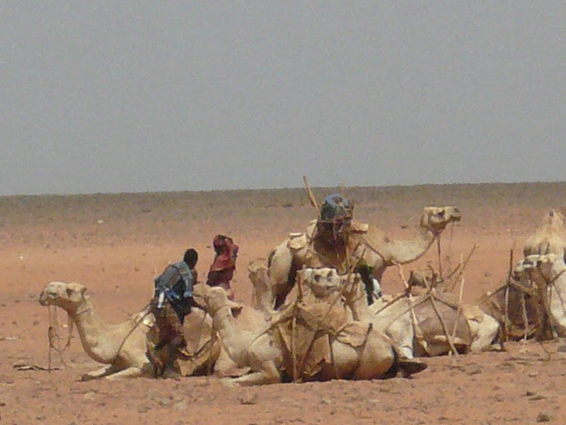
Poverty Traps, Resilience and Coupled Human-Natural Systems
Chris Barrett, Cornell University
May 20, 2016
8th Annual Conference on Economics and Catholic Social Thought
University of Chicago

Slide 2

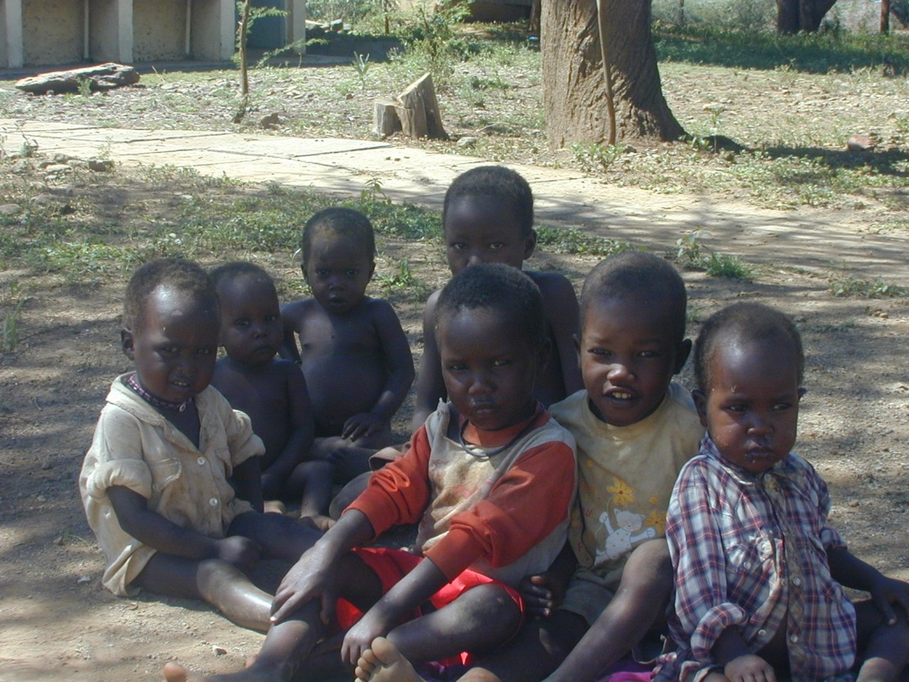
The Economics of Poverty Traps
Poverty trap = “self-reinforcing mechanism which causes poverty to persist” (Azariadis & Stachurski, HEG 2005).
Reinforcing feedback:
Low productivity causes poverty.
Poverty causes hunger and natural resource degradation.
But hunger and degraded natural resources also cause poverty and low productivity.
Hence the vicious cycle of poverty traps, hunger and natural resources degradation.

Slide 3
The Economics of Poverty Traps
There are 3 distinct types of poverty trap dynamics:
unique dynamic equilibrium systems (convergence on poor standard of living)
conditional convergence systems (unique equilibria for distinct groups, only some below a poverty line)
multiple equilibrium systems (initial condition guides resulting path dynamics)
(Carter and Barrett J. Dev’t Studies 2006; Barrett and Carter J. Dev’t Studies 2013; Barrett, Garg & McBride Annual Review Resource Economics 2016)

Slide 4
The Economics of Poverty Traps
Case (i): Welfare Dynamics With Unique Stable Dynamic Equilibrium: Unconditional Convergence
Well-being_{t+1}
Pov.
line
W₂
W₂
Well-being_{t}
Implies unique, common path dynamics. In expectation, no one escapes poverty. (Empirical examples: degraded rural highlands of Ethiopia, Kwak & Smith JDS 2013; Naschold JDS 2013)

Slide 5
The Economics of Poverty Traps
Case (ii): Welfare Dynamics With Distinct Stable Dynamic Equilibrium:
Conditional Convergence
High group
Well-being_{t+1}
W₂
Low group
Pov.
line
W₂
Well-being_{t}
Implies unique path dynamics with a single stable dynamic equilibrium that differs among distinct groups (Ex: SC/ST in rural India, social groups/rules; Naschold WD 2012)

Slide 6
The Economics of Poverty Traps
Case (iii): Welfare Dynamics With Multiple Stable Dynamic Equilibria
Chronic poverty region
`
Transitory poverty region
Non-poor region
Well-being_{t+1}
Pov.
line
Well-being_{t}
Implies nonlinear path dynamics with at least one unstable dynamic equilibrium/threshold effect/tipping point (Ex: East African pastoralists; soils; infectious disease-poverty interactions; nutritional poverty traps)

Slide 7
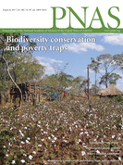
Poverty Traps, Ecology and Resilience
Existing economic theories of poverty traps closely parallel the ecological literature on resilience and resistance:
similar ODE-based mathematics of dynamical systems
important differences in framing … agency, intrinsic importance of individuals

Slide 8
Example: East African pastoralists
Arid and semi-arid lands (ASAL) cover ~ 2/3 of Africa, home to ~20mn pastoralists – who rely on extensive livestock grazing.
Pastoralist systems adapted to variable climate, but very vulnerable to severe drought events. Big herd losses cause humanitarian and environmental crisis.

Slide 9
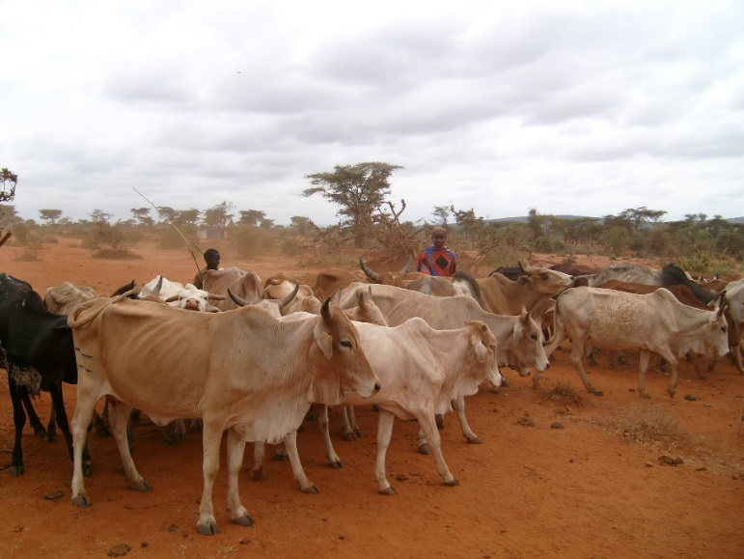
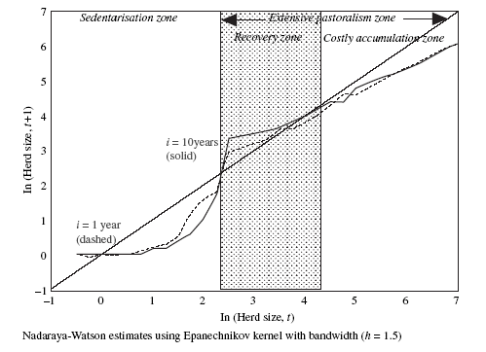
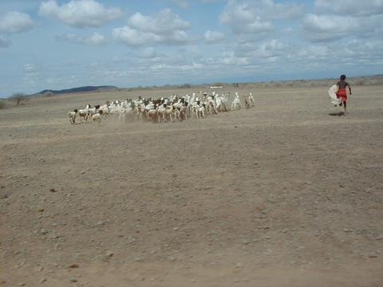
Example: East African pastoralists
In southern Ethiopia/ northern Kenya, pastoralists face nonlinear, bifurcated herd/wealth dynamics (Lybbert et al. 2004 Econ J.):
Source: Lybbert et al. (2004 EJ) on Boran pastoralists in s. Ethiopia. See also Barrett et al. (2006 JDS) among n. Kenyan pastoralists, Santos & Barrett (2011 JDE) on s. Ethiopian Boran; Santos & Barrett (2016 NBER);

Slide 10
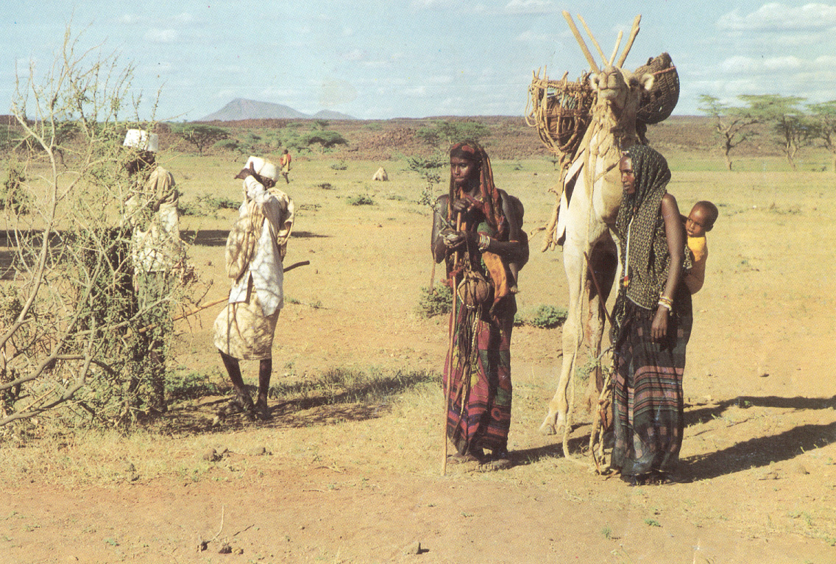
Example: East African pastoralists
Those who maintain a herd remain mobile on a resilient landscape, while those who lose their herd collapse into destitution on a degrading local landscape.

Slide 11
Weather shocks cause poverty traps
Not surprisingly, herd dynamics differ markedly between good and poor rainfall states.
Expected one year ahead herd dynamics with (A) poor rainfall or (B) good/normal rainfall. Points reflect herder-specific observations based on randomly assigned initial herd sizes. The solid line reflects stable herd size. The dashed line depicts the nonparametric kernel regression. (Barrett & Santos Ecol Econ 2014; Santos & Barrett NBER 2016)

Slide 12
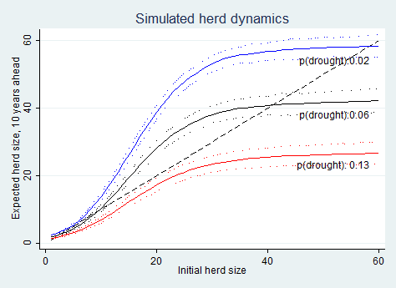
Increased Risk From Climate Change
Pastoralist systems adapted to climate regime. But resilient to a shift in climate? Many models predict increased rainfall variability (i.e., increased risk of drought).
Herd dynamics differ b/n good and poor rainfall states, and so change with drought (<250 mm/ year) risk.
Key: In so. Ethiopia, doubling drought risk would lead to system collapse in expectation in the absence of any change to prevailing herd dynamics.
Source: Barrett and Santos (Ecol Econ 2014)

Slide 13
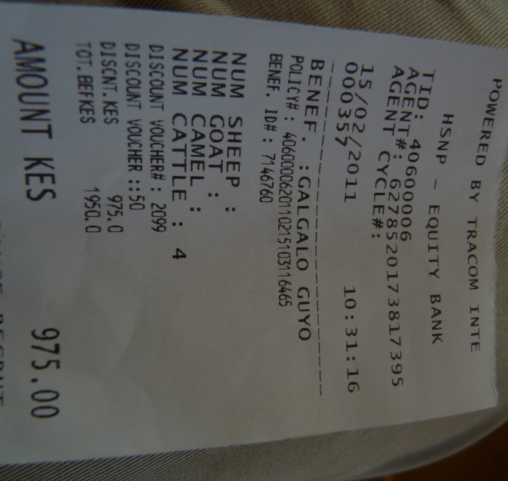
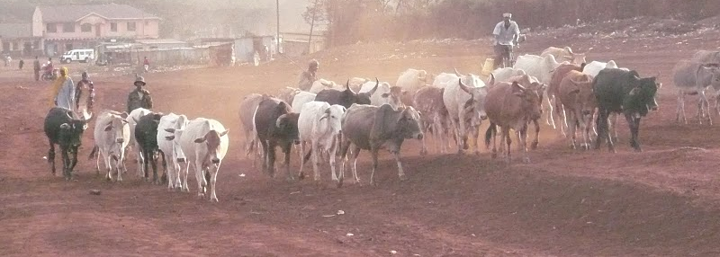
An Innovative Response: IBLI
For more information visit www.ilri.org/ibli/
Index-based livestock insurance to protect vs. drought
Individuals buy policies to protect their herds
Private underwriters, global reinsurers
Commercial pilot in Kenya in 2010; worked in 2011 drought
Now spread to Ethiopia, going nationwide in Kenya
Major, positive effects in both countries: 12-20x the marginal benefit/cost of cash transfer programs

Slide 14
Another example: Soils in SSA
Why such persistence?
There exists a positive correlation between GDPpc and annual soil nutrient fluxes.
Has productivity and nutrition consequences.
Mechanisms remain unclear.
(Barrett & Bevis, Nature Geoscience 2015)

Slide 15
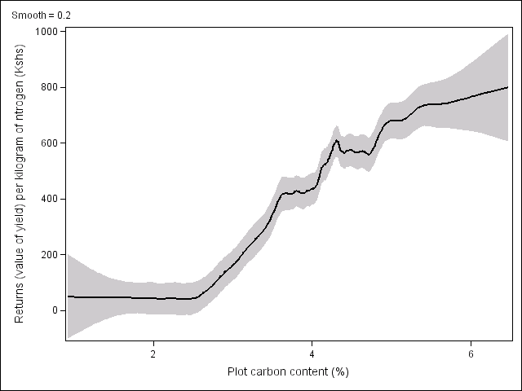
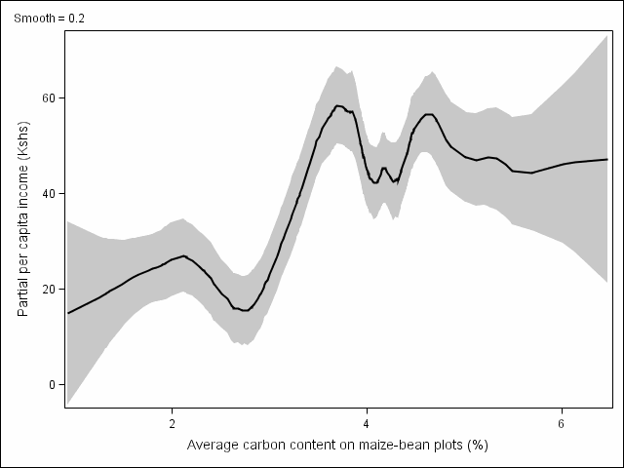
Another example: Soils in SSA
Why such persistence?
Soils degradation poverty traps
Marginal returns to fertilizer application low on degraded soils; and poorest farmers cultivate the most degraded soils. So the poor optimally don’t apply fertilizer, but stay poor.
Soil degradation also feeds a striga weed problem ($7bn/yr in crop losses), mycotoxin contamination of >25% of maize, and serious micronutrient deficiencies (e.g., Fe, Zn, I, Se).
Above red line: fertilizer profitable
Value of maize from 1 kg of nitrogen
Cost of 1kg nitrogen
Kenyan rural poverty line
Below red line: fertilizer unprofitable
(Marenya and Barrett, AJAE 2009; Stephens et al., Food Security 2012).

Slide 16
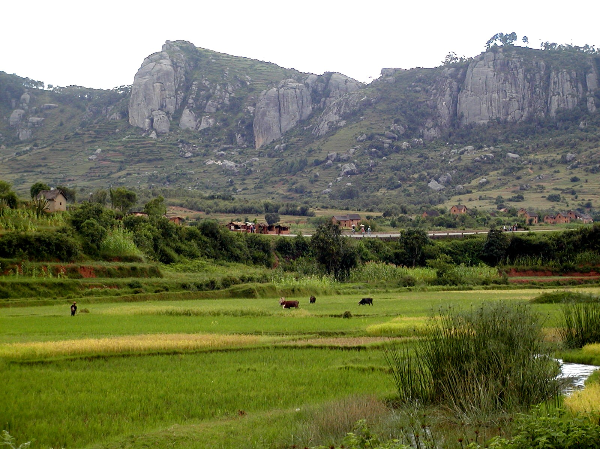
The result is pockets of productive, seemingly sustainable agro-ecosystems punctuated by neighboring economic and ecological problems

Slide 17
Poverty Traps and Resilience
Stochastic Well-Being Dynamics
Consider the moment function for conditional well-being:
m^{k}(W_{t+s} | W_{t}, ε_{t})
where m^{k} represents the k^{th} moment
W_{t} is well-being at the beginning of period t
ε_{t} is an exogenous disturbance (scalar or vector) during period t
These moment functions describe quite generally, albeit in reduced form, the stochastic conditional dynamics of well-being.

Slide 18
Toward Systems Integration
Feedback between sub-systems can be crucial
Generalize to admit the role of the natural resource state, R_{t}:
m^{k}(W_{t+s} | W_{t}, R_{t}, ε_{t})
And recognize that parallel dynamics exist for the resource:
rm^{k}(R_{t+s} | R_{t},W_{t}, ε_{t})
Now feedback potentially arises between R and W
(e.g., range conditions depend on herd size/stocking rate, disease reproduction depends on household incomes)
Or at least correlation due to ε_{t} (e.g., climate).
Then the resilience of the underlying resource base becomes instrumentally important to resilience against chronic poverty.

Slide 19
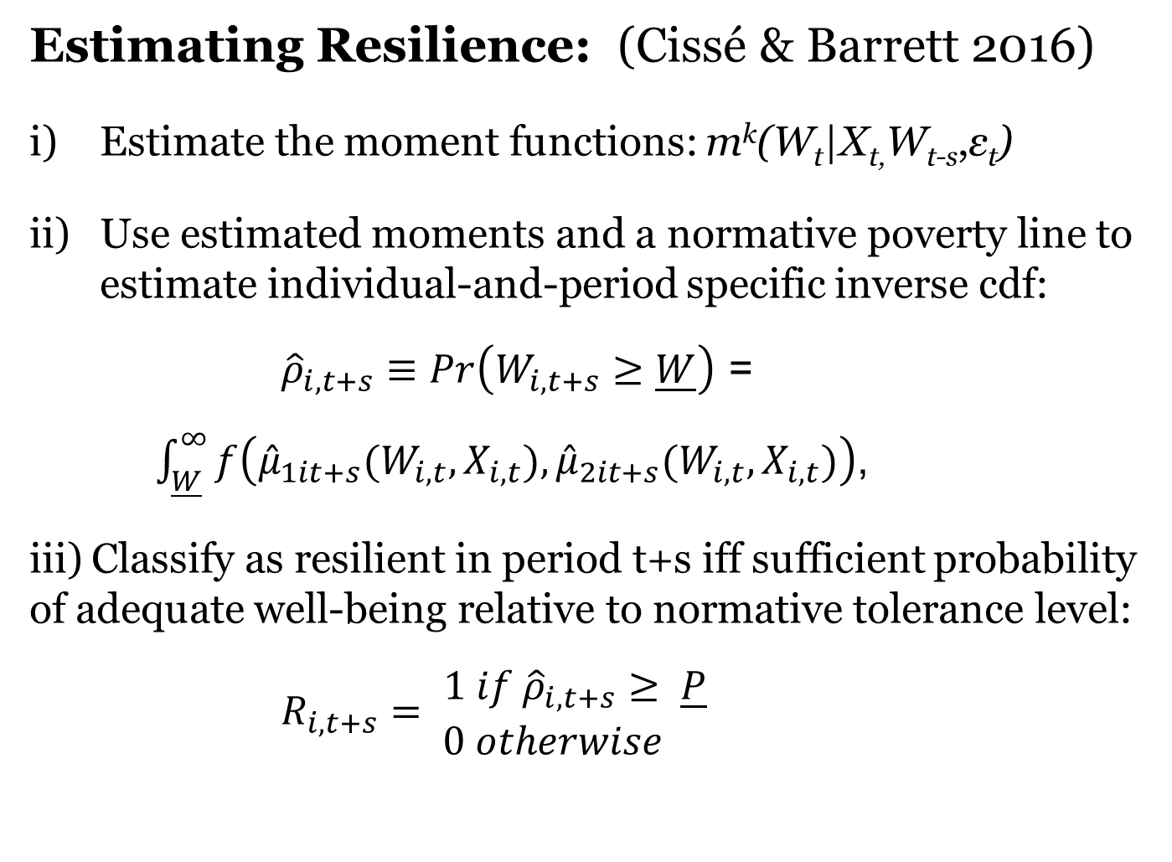
Estimating Resilience
Estimating Resilience: (Cissé & Barrett 2016)
Estimate the moment functions: m^{k}(W_{t}|X_{t,}W_{t-s},ε_{t})
Use estimated moments and a normative poverty line to estimate individual-and-period specific inverse cdf:
${\hat{ρ}}_{i,t+s}≡Pr\left(W_{i,t+s}≥\underline{W}\right)$ =
$\int_{\underline{W}}^{∞}{f\left({\hat{μ}}_{1it+s}(W_{i,t},X_{i,t}),{\hat{μ}}_{2it+s}(W_{i,t},X_{i,t})\right)}$,
iii) Classify as resilient in period t+s iff sufficient probability of adequate well-being relative to normative tolerance level:
$R_{i,t+s}= \begin{matrix}1 if {\hat{ρ}}_{i,t+s}≥ \underline{P} \\ 0 otherwise \end{matrix}$

Slide 20
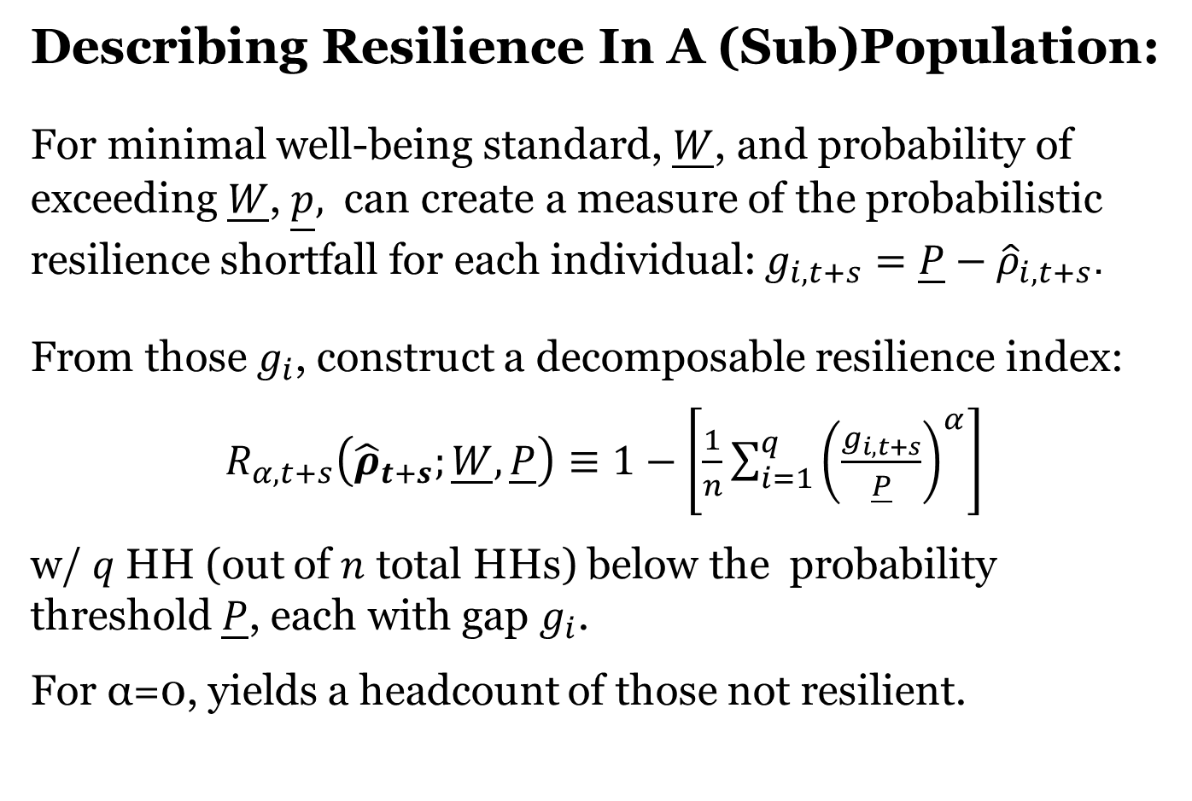
Describing Resilience
Describing Resilience In A (Sub)Population:
For minimal well-being standard, $\underline{W}$, and probability of exceeding $\underline{W}$, $\underline{p},$ can create a measure of the probabilistic resilience shortfall for each individual: $g_{i,t+s}=\underline{P}−{\hat{ρ}}_{i,t+s}$.
From those $g_{i}$, construct a decomposable resilience index:
$R_{α, t+s}\left({\hat{ρ}}_{t+s};\underline{W},\underline{P}\right)≡1−\left[\frac{1}{n}\sum_{i=1}^{q}{{\left(\frac{g_{i,t+s}}{\underline{P}}\right)}^{α}}\right]$
w/ $q$HH (out of $n$ total HHs) below the probability threshold $\underline{P}$, each with gap $g_{i}$.
For α=0, yields a headcount of those not resilient.

Slide 21
Summary
The economics of poverty traps links naturally to much ecological research, especially that concerned with dynamics, stability and resilience.
A prime opportunity for linking development and environmental economics (and ecology):
- Help identify how best to reduce chronic poverty and to safeguard ecosystems vulnerable to anthropogenic disruptions.
This will require advances in theory, measurement, impact evaluation and outreach in different contexts and over time.

Slide 22
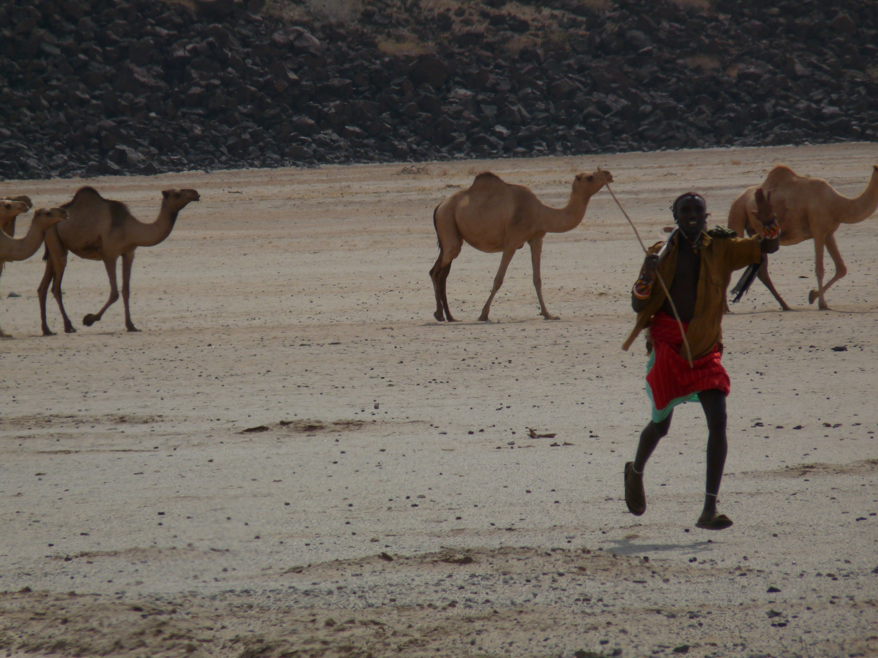
Thank you for your time and interest!

